Slide 1

Indian Institute of Information Technology Vadodara International Campus Diu
FLIGHT RESERVATION SYSTEM
Group 6
Karthik Jadhav 202411045
Shivam Raval 202411080
Ashitosh Shirsath 202411088
Helen Mary 202411102

Slide 2

FLIGHT RESERVATION SYSTEM

Slide 3
PROJECT OVERVIEW
System Purpose
Flight Reservation System using Object-Oriented Programming with file handling. It supports two types of users
USER CLASS
ADMIN and CUSTOMER
ADMIN CLASS : USER CLASS
CUSTOMER CLASS : USER CLASS
Register/Login
Add new flights
View all flights
View all passengers
View all bookings & cancellations
File – ADMIN_DETAILS.txt
Register/Login
View all flights
Booking ticket
Cancel ticket
File – CUSTOMER_DETAILS.txt
Exception Management

Slide 4
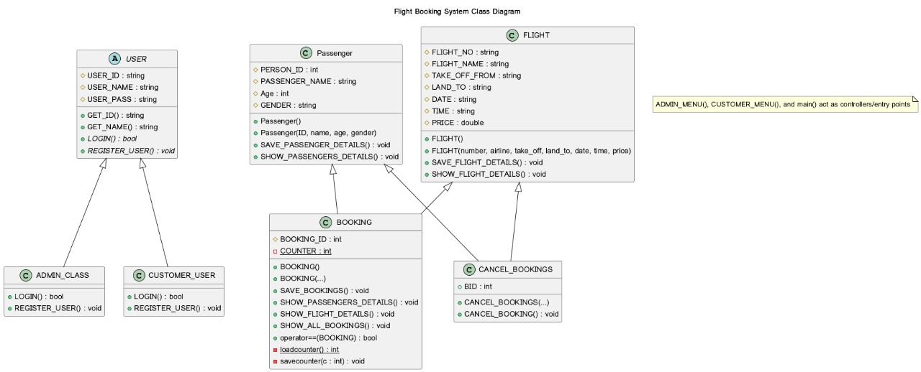
SYSTEM ARCHITECTURE
Design Pattern

Slide 5
CORE FEATURES
⚙️ ADMIN OPERATIONS
Add new flights with complete details including flight number, airline, departure, destination, date, time, and pricing in the
File – FLIGHT_details.txt
View all available flights in the system with comprehensive route and schedule information
File – FLIGHT_details.txt
✈
📋
View all registered passengers with their personal details and identification information
File – PASSENGER_details.txt
View all active bookings with passenger and flight information for operational oversight
File – BOOKING_details.txt
👥
🎫
View all cancelled bookings with refund calculations and cancellation history
File – CANCAL_BOOING_details.txt
❌

Slide 6
CORE FEATURES
👤 CUSTOMER OPERATIONS
Secure registration and login with unique customer ID and password authentication
File – Passenger_details.txt
Add passenger details including name, age, and gender for booking purposes
File – Passenger_details.txt
🔐
👨
view all available flights with complete route, schedule, and pricing information
File – FLIGHT_details.txt
Book flights by selecting from available options and providing passenger information
File – BOOKING_details.txt
🔍
✅
Cancel booked tickets with automatic refund calculation and cancellation confirmation
File – CANCEL_BOOING_details.txt
🔄

Slide 7
USER AUTHENTICATION & MANAGEMENT
🔐 Authentication System
The system implements secure login and registration for both Admin and Customer roles with file-based credential storage, password validation, and role-specific access controls. Each user type has dedicated authentication flows and access permissions.
👨 ADMIN AUTHENTICATION
👤 CUSTOMER AUTHENTICATION
Login with Admin ID, Name, and Password. Full system management including flight management, booking oversight, and passenger tracking.
Login with Customer ID, Name, and Password. Limited to booking operations, passenger management, and flight browsing.
File – Admin_details.txt
File – Customer_details.txt

Slide 8
USER AUTHENTICATION & MANAGEMENT
🛡Security Features
Comprehensive validation of user credentials, prevention of duplicate registrations, encrypted credential storage, and role-based access control ensure system security and data integrity.
Credential Storage
Password Validation
All Data is stored in the File handling files with their respective file names
Secure credential matching and verification , also it is present in the file
Duplicate Prevention
Double Entry Not accepted
It prevents same name is fine but same id is not accept because all passengers have their own unique id
Single customer can’t register twice

Slide 9
PASSENGER CLASS
✈ Passenger Registration
enter personal details such as Name, Age, Gender, Aadhar(ID). After registration, the passenger is stored in the system and can later be used for booking a flight
File – Passenger_details.txt
PASSENGER ID
A unique identification number assigned to each passenger. It helps in managing bookings and avoids duplicate records
PASSENGER NAME
🔍 Unique Passenger Identification
Stores the full name of the passenger. Used for identification during booking and travel verification
Every passenger has unique identity attributes like Aadhar(ID). This avoids duplicate entries and helps in uniquely identifying each passenger during booking or cancellation.
AGE
Represents the age of the passenger. Useful for applying special rules such as child or senior citizen discounts
📊Secure Information Handling
Sensitive passenger data is not shown publicly unless required for booking or verification. Helps ensure privacy and secure handling of user details.
GENDER
Specifies the gender of the passenger (e.g., Male/Female/Other). Used for reporting and airline seating policies if required

Slide 10
FLIGHT CLASS
✈Admin Operations
Flight Number
Admin can add new flights with complete details including flight number, airline name, departure and destination cities, date, time, and pricing. The system prevents duplicate routes and maintains a comprehensive flight database for operational efficiency.
File – FLIGHT_details.txt
Unique identifier for each flight
Airline Name
Operating airline information such as flight name
🔍 Flight Management
Route Information
Add new flights and view all flights with validation to prevent duplicate routes. Each flight is assigned a unique flight number and comprehensive route information for easy identification and scheduling.
Departure and destination cities
Schedule
Date and time of departure
📊 Database Maintenance
Comprehensive flight database ensures operational oversight with complete flight information including schedules, pricing, and availability for customer booking operations.
Ticket Pricing
Cost per passenger

Slide 11
BOOKING & CANCELLATION CLASS
✅ BOOKING WORKFLOW
❌ CANCELLATION WORKFLOW
1
Browse Flights
1
View Bookings
Customer views available flights with complete route and pricing information
Customer accesses list of active bookings
2
Select Flight
2
Select Booking
Choose desired flight from available options based on schedule and price
Choose booking to cancel from active reservations
3
Provide Passenger Info
3
Confirm Cancellation
Enter passenger details including name, age, and gender
System requests confirmation before processing cancellation
4
Confirm Booking
4
Calculate Refund
System generates unique booking ID and confirms reservation
System computes refund amount based on cancellation policy
5
Booking History
5
Record Cancellation
Booking recorded in customer history for future reference
File – BOOKING_details.txt
Cancellation tracked in system with refund confirmation
File – CANCEL_BOOKING_details.txt

Slide 12
DATA PERSISTENCE LAYER
The system employs file-based storage architecture to maintain data persistence across sessions. Each functional module has dedicated text files that store structured data with clear delimiters.
Storage Type
Text Files (.txt)
👤
👥
✈️
Admin Details
Customer Details
Flight Details
Admin credentials, IDs, names, passwords
File – ADMIN_details.txt
Customer credentials, IDs, names, passwords
File – CUSTOMER_detials.txt
Flight numbers, routes, dates, times, prices
File – FLIGHT_details.txt
🧑
🎫
❌
Passenger Details
Booking Details
Cancellations
Passenger IDs, names, ages, genders
File – PASSENGER_details.txt
Booking IDs, passenger info, flight data
File – BOOKING_details.txt
Cancelled bookings, refund info, timestamps
File – CANCEL_BOOKING_details.txt
Simplicity
Persistence
Transparency
Easy to implement and understand without database complexity
Data survives application restarts and sessions
Human-readable format for easy debugging and verification

Slide 13
EXCEPTION HANDLING & VALIDATION
🛡Exception Handling
✔ Data Validation
Invalid Input
Credential Validation
Try-catch blocks catch invalid input exceptions when non-numeric values are entered
Verifies user ID and password match stored credentials before login
File Operations
Duplicate Prevention
Handles file not found, read/write failures, and stream errors gracefully
Prevents adding duplicate passengers with same ID to system
Memory Allocation
Route Uniqueness
Catches bad_alloc exceptions when dynamic memory allocation fails
Ensures no duplicate flights exist on same departure-destination route
Runtime Errors
Existence Checks
Handles unexpected runtime conditions and recovers gracefully
Verifies files exist before reading and handles missing data files
Error Recovery
Data Integrity
System clears input buffers, resets flags, and prompts users to retry operations
Maintains consistency across operations and prevents invalid state transitions
User Feedback
Input Sanitization
Clear error messages guide users on correcting invalid inputs
Validates all user inputs before processing and storing in database

Slide 14
TECHNICAL IMPLEMENTATION
Primary Language
Concept
Architecture
C++23
OOP
Class-Based
Modern C++ with advanced features
Object-Oriented Programming
Inheritance & Polymorphism
🏗️
🔄
🔒
Inheritance
Polymorphism
Encapsulation
Core Features
File & Error Handling
Virtual Functions
File I/O Operations
Enables polymorphic behavior through method overriding
ifstream and ofstream for reading/writing data in respective files
Multiple Inheritance
Exception Handling
BOOKING class inherits from both Passenger and FLIGHT
Try-catch blocks for error management
Dynamic Allocation
String Manipulation
For booking the tickets and store it in file dynamically approach
String parsing and data extraction operations

Slide 15
CONCLUSION
The Flight Reservation System demonstrates solid software engineering principles with comprehensive functionality for managing flight operations, user authentication, and booking management.
🏗️
🔐
Robust Architecture
Secure Authentication
Object-oriented design with inheritance and polymorphism for scalable code
Dual-role access control with credential validation and permissions
⚙️
💾
Complete Functionality
Data Persistence
End-to-end flight management, booking, and cancellation operations
Reliable file-based storage ensuring data integrity across sessions

Slide 16

THANK YOU

